Slide 1
GIT AND GITHUB

Slide 2
INTRODUCTION
Git is a mature, actively maintained open source project originally developed in 2005.
Git was originally authored by Linus Torvalds for development of the Linux kernel. Since 2005, Junio Hamano has been the core maintainer.%

Slide 3
GIT
The main objectives of Git are speed, data integrity, and support for distributed, non-linear workflows
Git is a DevOps tool used for source code management.
It is a free and open-source version control system used to handle small to very large projects efficiently.
Git is used to tracking changes in the source code, enabling multiple developers to work together on non-linear development.

Slide 4
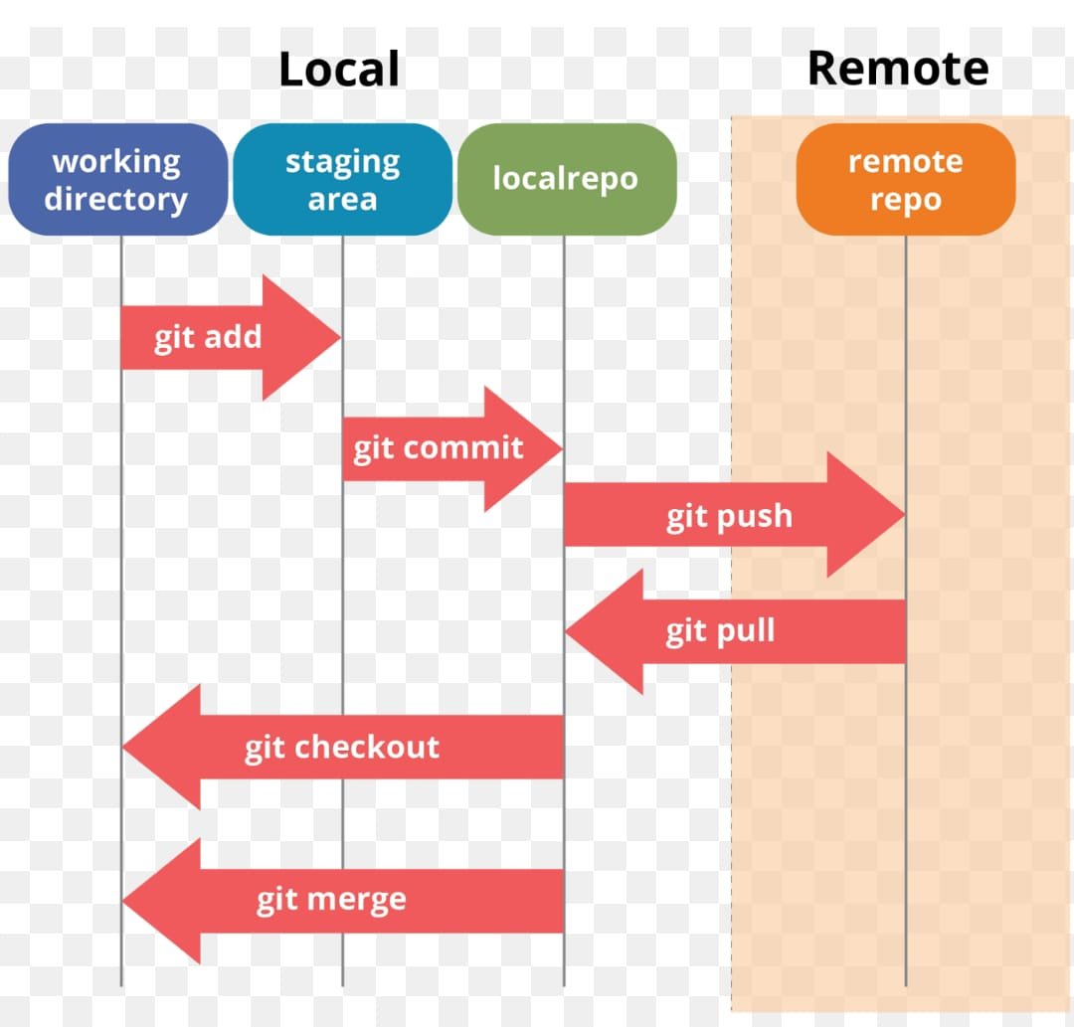
GIT WORKFLOW

Slide 5
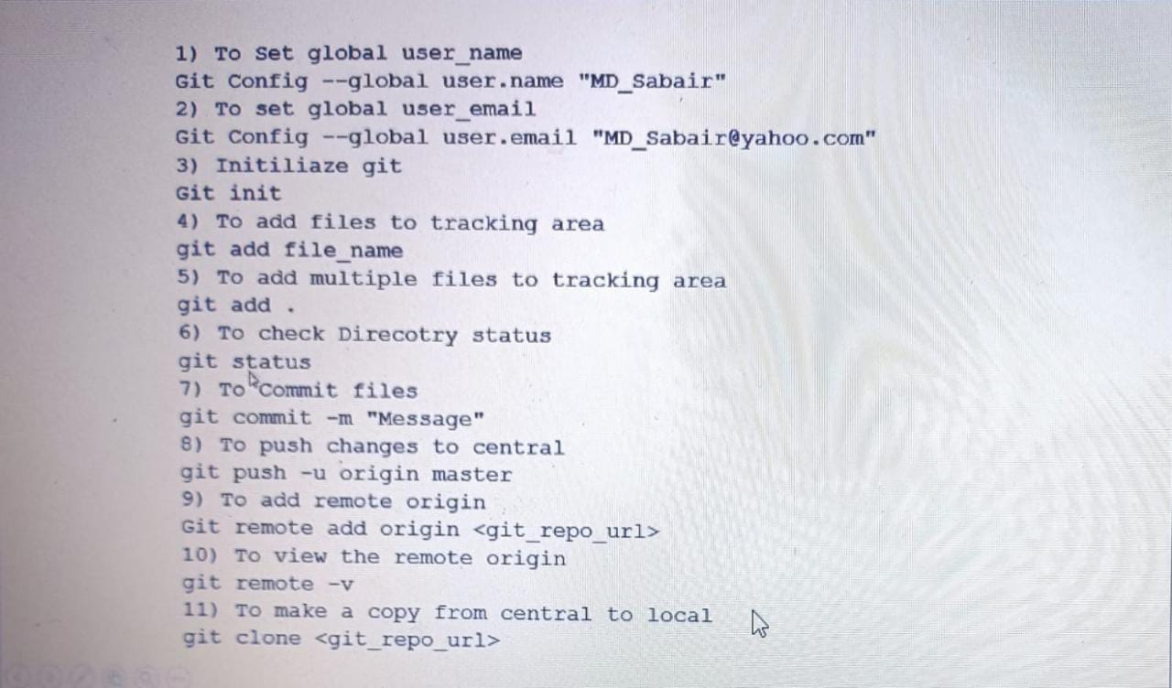
GIT COMMANDS

Slide 6
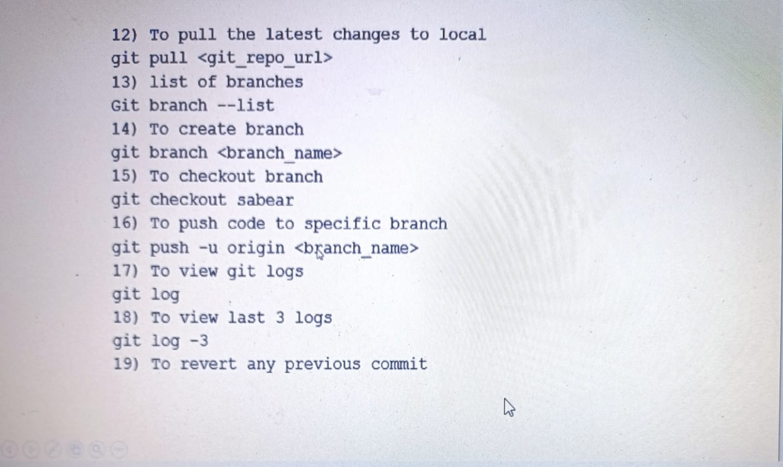

Slide 7
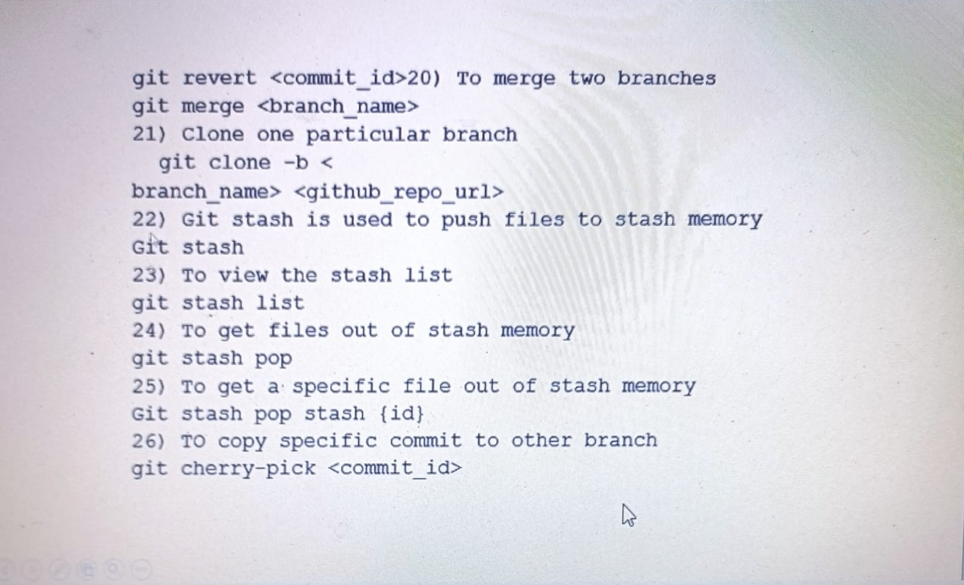

Slide 8
GITHUB
GitHub is a centralized version control system
GitHub is a code hosting platform for version control and collaboration. It lets you and others work together on projects from anywhere.

Slide 9
GITHUB
GitHub is a code hosting platform for version control and collaboration. It lets you and others work together on projects from anywhere. This tutorial teaches you GitHub essentials like repositories, branches, commits, and pull requests.

Slide 10
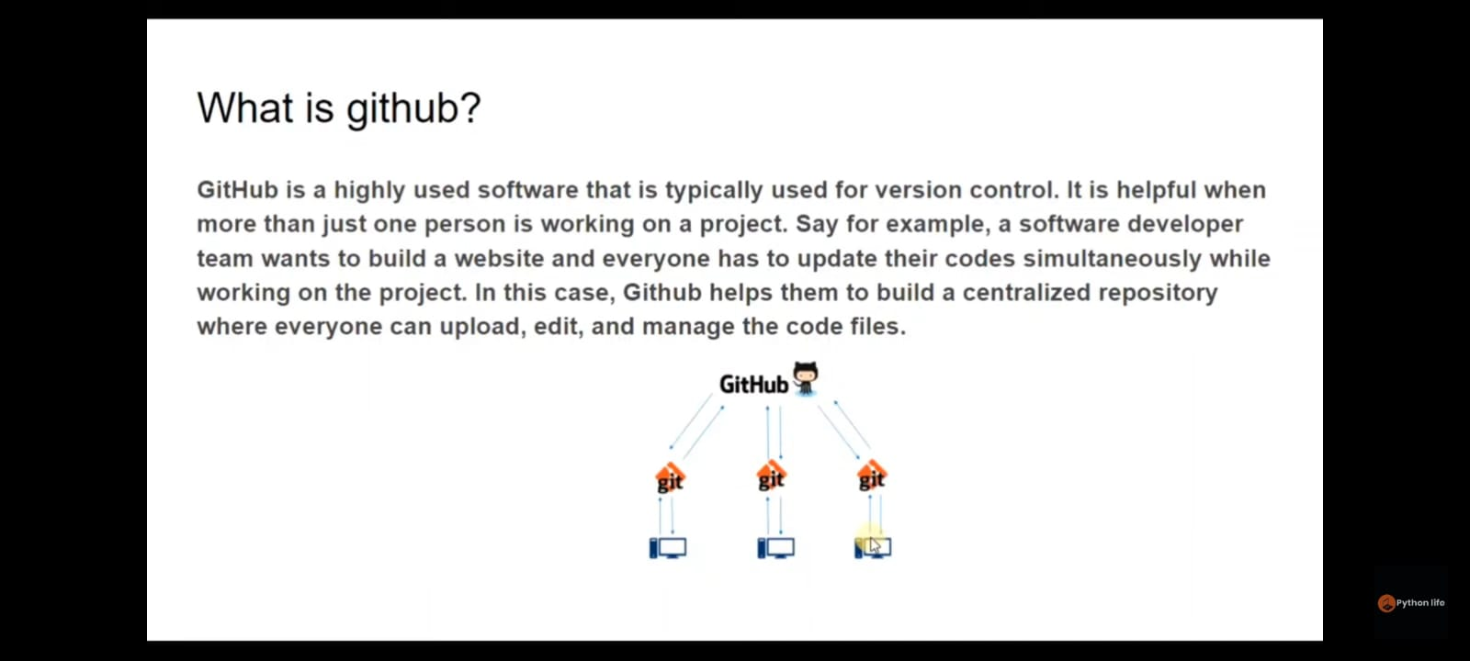

Slide 11
DIFFERENCE BETWEEN GIT AND GITHUB
GIT
Git was first released in 2005.
Git is a version control system that lets you manage and keep track of your source code history.
Git is a command‑line tool
Git is installed locally on the system
Git is maintained by linux.
GITHUB
GitHub was launched in 2008.
GitHub is a cloud-based hosting service that lets you manage Git repositories.
GitHub is a service.
GitHub is hosted on the web
GitHub is maintained by Microsoft.

Slide 12
THANK YOU

